Slide 1



Slide 2


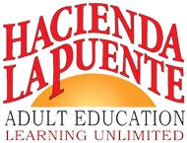



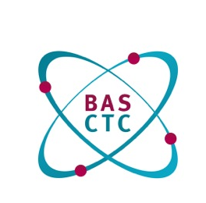
In 2015
Mt. SAC Consortium
Program Area 2 – Classes for Immigrants
English as a Second Language
Areas of Competencies:
Listening, Speaking, Reading
Writing and Grammar
Participants: Baldwin Park: George Funk, Bassett: Louis Kreslie, Linda Packard, Trudi Sparnicht
Hacienda-La Puente: Nadine Elhaj, Mt. SAC: Maria Azpeitia, L.E. Foisia, Mina Fowler,
Pomona: Judy McFadden, Rowland: Cynthia Clark, Nancy Lopez, Janna Socash, Ami Takanashi,
Tri-Community: Victoria Bañuelos, Celia Carter, Cornella Ver Halen

Slide 3
Measuring student success
Key outcomes for ESL
Improved Literacy
Advance at Least One Educational Functioning Level
Transition to Credit or ABE/ASE
Career / Job Placement

Slide 4
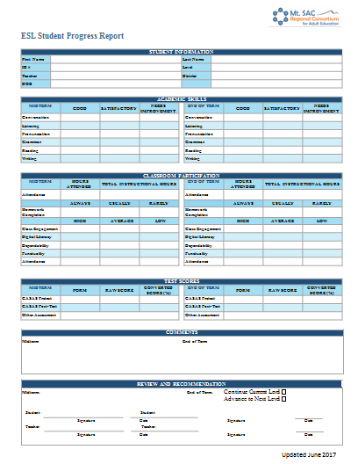

Slide 5


